Slide 1
Geodetic Acoustic Ray Solutions in the Time Domain
Mr. Sean Reilly
University of Rhode Island
Ocean Engineering Department
January 2011

Slide 2
Filling a need in Undersea Computational Acoustics
Existing TL models doing a poor job of supporting real-time sonar simulations with humans or hardware in the loop.
Too slow, hard to integrate, poor software engineering.
Many currently attempt to solve problem using Moore’s Law (throwing hardware at it), but this is turning out to be cost prohibitive.
Greatest need is currently for active sonar applications, not passive.

Slide 3
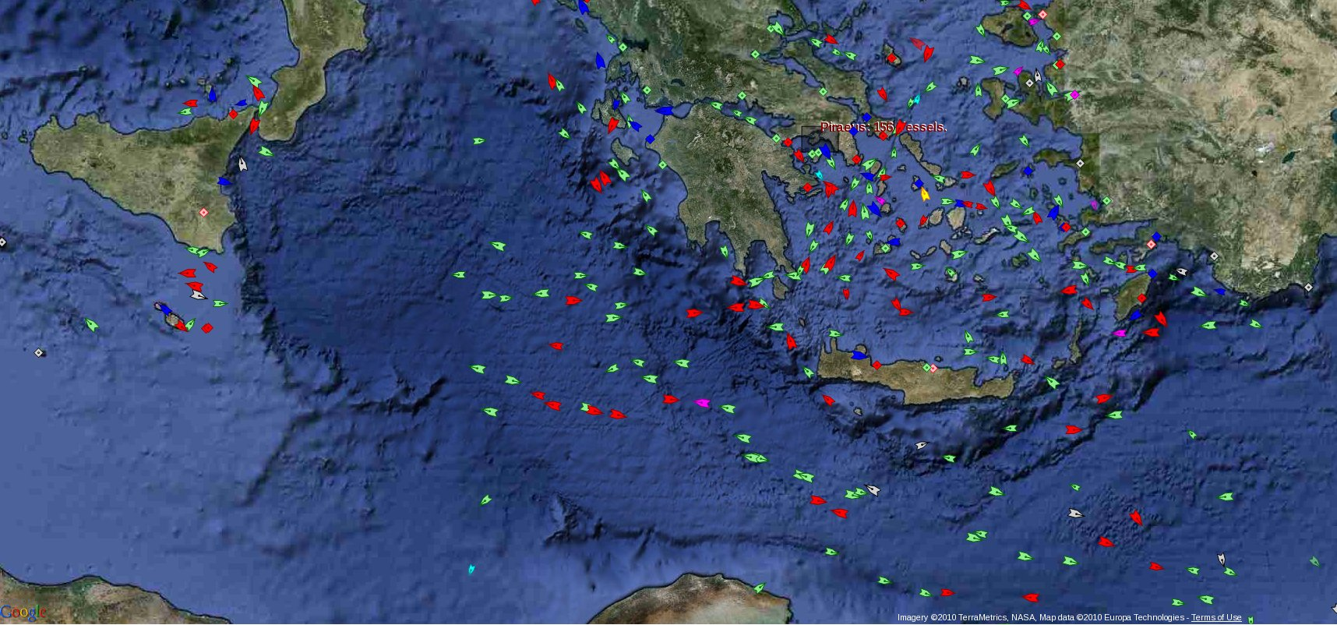
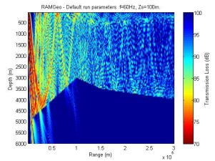
Objective Scenario
Bottom limited environment but deep enough for submarine operations.
Gridded 4-D environmental data from a variety of sources.
Frequencies > 1000 Hz but interest in extending lower.
Process hundreds of targets per sensor on a laptop.
Reverberation handled in a different way than targets.
Need accuracy on-par with existing state-of-the-art.
AIS merchant ship traffic report from MarineTraffic.com on 02-16-10
TL image from http://cmst.curtin.edu.au/products/actoolbox/

Slide 4
Implementation Driven Derivation
Take a fresh look at the underlying assumptions of prior state-of-the-art from the perspective of their impact on the implementation.
Do the “hard work” during derivation to save cycles at run-time.
But assume that # of targets is small compared to # of environmental data points.
Produce a modeling product that follows good OO software engineering practices.

Slide 5
Rays as Wavefronts
Ray theory good match for most assumptions.
But we include Gaussian beams to extend support to lower frequencies.
Implement 3-D ray tracing in time domain to maintain phase continuity of the wavefront.
Assumes that smoother wavefront can characterize wavefront with fewer rays.
Use Boost uBLAS vector C++ library to optimize speed.
Unwraps vector calculations to take advantage of the pipeline architecture of modern CPUs (ex: Pentium).

Slide 6
Geodetic 3-D Ray Tracing
Earth’s axis
area of operations
h
R
center of
equator
the earth
latitude
center of
curvature
longitude
Save time by performing calculations in same lat/long coordinate system as databases.
Support out of plane effects as a by-product.

Slide 7
Adams-Bashforth 3 Integrator
Estimates next step from the previous 3 steps.
Implement as a circular queue of 4 wavefronts.
Limits interpolation of sound speed and derivative to once per iteration. Huge impact on speed!
Single calculation of sin θ, and cot θ per iteration.
Combination of geodetic ray trace, AB3 integrator, and queue implementation optimizes speed and accuracy.
But AB3 not self starting. Requires slower Runge-Kutta (RK3) during initialization and reflection.

Slide 8
Reflection from 3-D Slope
s
A
A
R
I
= surface normal at reflection point
= incident ray path direction
= reflected ray path direction
= component of incident ⊥ to normal
= time delay until reflection
Coherence of wavefront will allow interface collisions to be re-used in fast reverberation modeling follow-on.

Slide 9
Eigenray Estimation
Taylor series on CPA derivative
d = distance from target to wavefront point
ρ = offset from CPA in time, D/E, AZ
b = gradient of squared distance at CPA, and
A = Hessian matrix of squared distance at CPA.

Slide 10
Hybrid Gaussian Beams
Ray spreading estimates divergence instead of dynamic ray equations.
Shadow zones act like evanescent leakage from neighbouring cells.
Wavefront keeps contributions in phase.
Shading in ray space is convolution in wavenumber space.
Launch D/E
μ
j+2
Gaussian
beam centers
μ
j+1
μ
j
Eigenray
Target
Peak α 1/width
μ
j
-
1
ϕ
ϕ
ϕ
ϕ
k
-
1
k
k+1
k+2
Launch AZ
Reference: H. Weinberg, R. E. Keenan, “Gaussian ray bundles for modeling high-frequency propagation loss under shallow-water conditions.”

Slide 11
Software: Foundations Complete
Isolates model from ocean data sources.
Geodetic coordinate system foundations.
Fast, generic interpolators.
Extends uBLAS supported operations.
Geodetic Acoustic Rays
Wave Fronts
Eigenray Results
Proploss Results
NetCDF Files
Fundamental Data Types
Ocean Components
Bathymetry
Ocean Profiles
COARDS, WOA, ETOPO
Data Grids
Sequences
World Coordinates
Profiles
Attenuation
Boundaries
Reflection Loss
uBLAS Extensions
uses
abs, arg, sqrt, max, ...
cos, acos, cosh, acosh, ...
exp, log, pow, ...

Slide 12
Test Driven Development (TDD)
Start the development of each new feature by first designing its unit test.
Every module includes a “test” directory.
Detect and record failures to match analytic results.
Readiness of each new feature defined by the quality of its test.
Boost Test Library Unit Test Framework (UTF) to implement these goals.
Organizes all units tests into a regression suite.
Verification testing of the implementation designed to demonstrate validity of derivation.

Slide 13

Timing: Heading in Right Direction
Alion IRAD - July 2006 (Reilly, Goodrich)
Ray tracing components of Geodray 6-20 times faster than equivalent parts of FeyRay.
NWDC V&V – June 2009 (Reilly, Foreman, Fulford)
FeyRay accepted by CNMOC for M&S use.
FeyRay accuracy within 5% of GRAB
FeyRay 5-20 times faster than GRAB
Results contentious – But they support the conclusion that speed improvement goals may be viable.

Slide 14
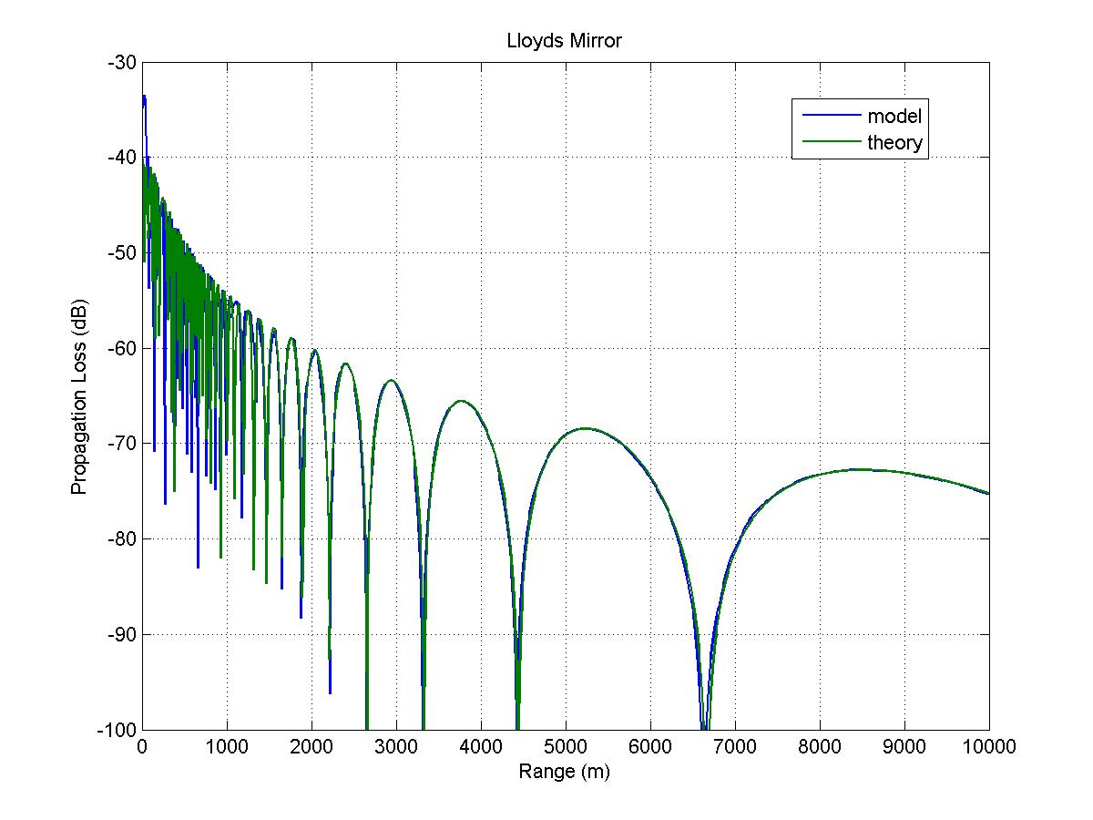
Lloyd's Mirror Test
Source: 25 meters deep
Target: 25 meters deep
Frequency: 2000 Hz
Time Step: 50 msec
Flattened Earth, Classic Ray Theory

Slide 15
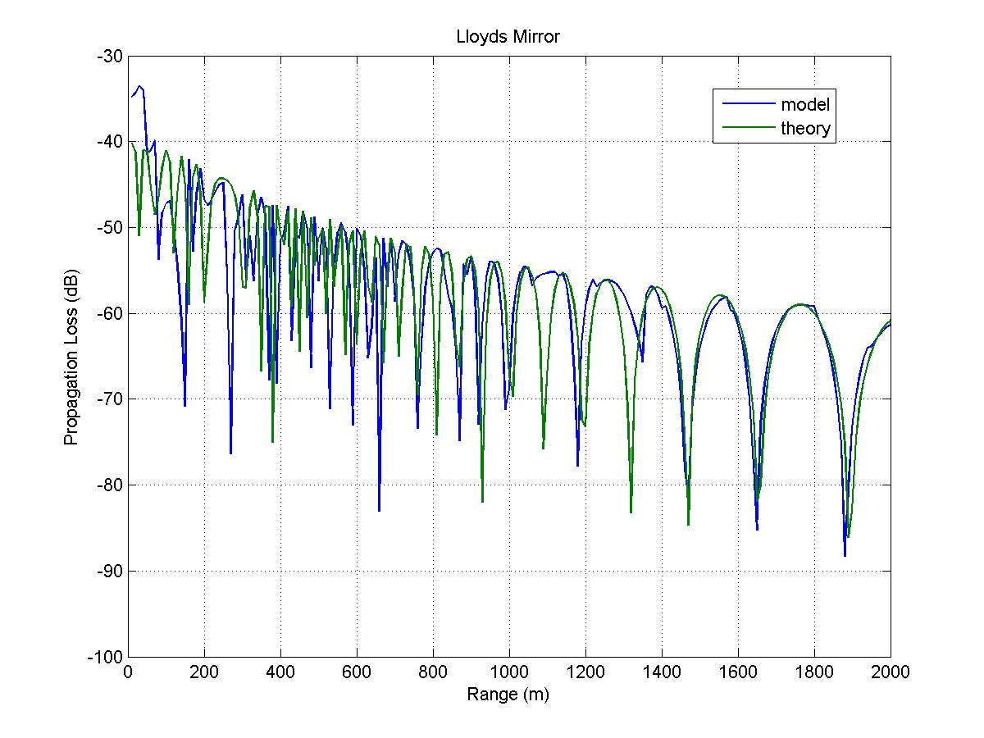
Lloyd's Mirror Close-up
Source: 25 meters deep
Target: 25 meters deep
Frequency: 2000 Hz
Time Step: 50 msec
Flattened Earth , Classic Ray Theory

Slide 16
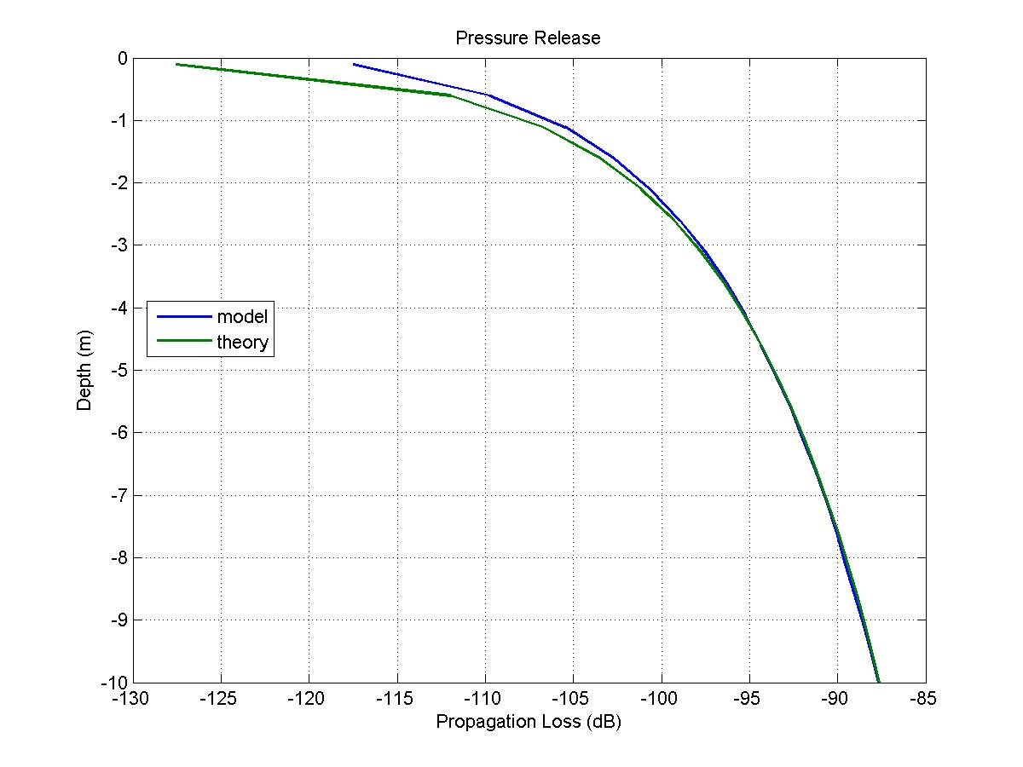
Pressure Release Test
Source: 25 meters deep
Target: 10 km away
Frequency: 2000 Hz
Time Step: 50 msec
Flattened Earth , Classic Ray Theory

Slide 17
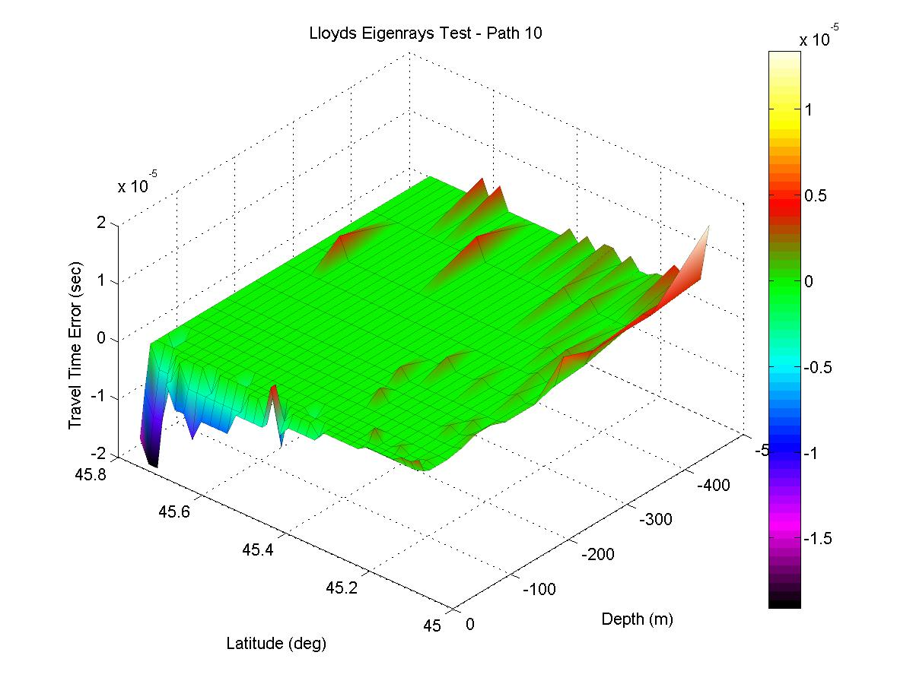
Lloyd's Mirror on Round Earth

Slide 18
Further Reading
V. Cerveny, M. M. Popov, and I. Psencik, “Computation of wave fields in inhomogeneous media – Gaussian beam approach,” Geophys. J. R. Astron. Soc., 70, pp. 109-128, 1982.
R.M. Jones, J.P. Riley, T.M. Georges, “HARPO: A Versatile Three-Dimensional Hamiltonian Ray-Tracing Program for Acoustics Waves in an Ocean with Irregular Bottom,” NOAA, 1986.
M. B. Porter, H. P. Bucker, “Gaussian beam tracing for computing ocean acoustic fields,” J. Acoust. Soc. Am. 82 (4), October 1987.
Ziomek, Lawrence, "The RRA Algorithm: Recursive Ray Acoustics for Three-Dimensional Speeds of Sound," IEEE Journal of Oceanic Engineering, vol. 18 no. 1, January 1993.
H. Weinberg, R. E. Keenan, “Gaussian ray bundles for modeling high-frequency propagation loss under shallow-water conditions.” J. Acoust. Soc. Am. 100 (3), 1421-1431, Sept 1996.
P. A. Baxley, H. Bucker, M. B. Porter, “Comparison of Beam Tracing Algorithms,” Proceedings of the Fifth European Conference on Underwater Acoustics, ECUA 2000.
F. B. Jensen, W. A. Kuperman, M. B. Porter, and H. Schmidt, Computational Ocean Acoustics, American Institute of Physics Press, New York.
The FEYRAY Gaussian Beam Underwater Acoustic Propagation Model, Terry L. Foreman, Navy Warfare Development Center, 5 Jan 2007.

